Slide 1
What is a Game?
Kathleen Mercury
Engineering Strategy Games

Slide 2
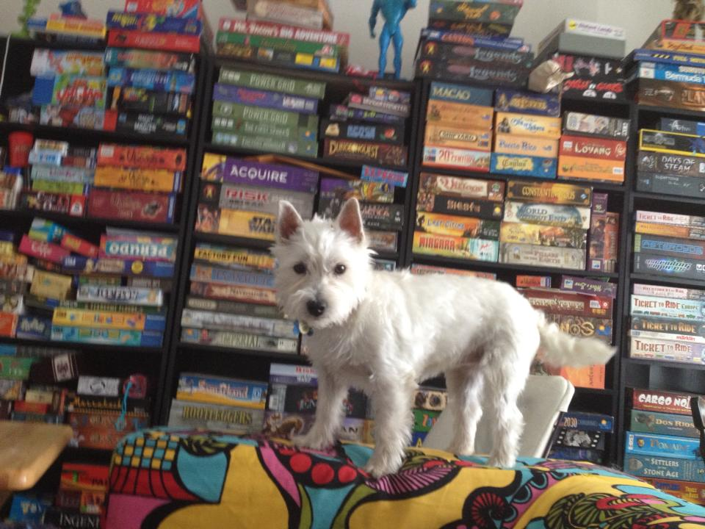
What is a game?
With a partner, brainstorm a definition and be prepared to share it.

Slide 3
Ideas from our brainstorming:
(Put this slide on the screen, type or use SmartBoard markers to jot students’ ideas)

Slide 4
Our final definition of what is a game:

Slide 5
Others’ Definitions
How does our definition compare?

Slide 6
Definition of a game
Game = Play + Goals + Structure

Slide 7
Definition of a game
A set of algorithms that change state

Slide 8
Definition of a game: Jane McGonigal
An activity with four defining traits
Goal
Rules
Feedback system
Voluntary participation

Slide 9
Definition of a game: Bernard Suits
To play a game is to attempt to achieve a specific state of affairs (prelusory goal)
using only means permitted by rules (lusory goals)
where use of the rules prohibit more efficient means (constitutive rules)
and where the rules are accepted just because they make possible such activity (lusory attitude).

Slide 10
Definition of a game: Oxford Dictionary
A form of play or sport, especially a competitive one according to rules and decided by skill, strength, or luck.

Slide 11
Definition of a game: Wikipedia
A game is any activity undertaken or regarded as a contest involving luck, skill, or a combination of both, and played according to a set of rules for the enjoyment of the players or spectators.
A strategy game is a game where players’ decision-making skills have a high significance in determining the outcome of the game.
These decision-making skills do not occur by accident; game designers create games to generate specific actions, behaviors, and outcomes.

Slide 12
With a Partner…
Write your final definition of what a game is, and be sure to include what you think is most important.

